Slide 1

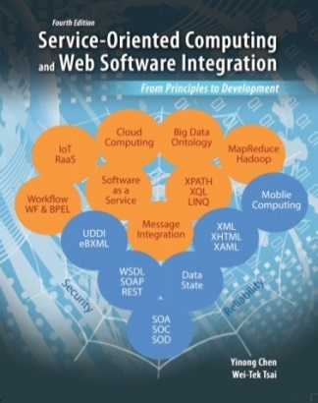
Presentation Layer Design -- Dynamic Graphics Generation -- Animation -- Mobile Applications -- MVC
CSE 445 / 598
Distributed Software Development
Lecture 25
7
Presentation
Layer (GUI)
5
5
Application
Processing Layer
Textbook Chapter 5, Section 5.6
Service Repository
Layer
Dr. Yinong Chen
https://myasucourses.asu.edu/
Data Management
Layer

Slide 2
“One picture is worth a thousand words”
Static graphics is important in Web design;
It is available in Web 1.0;
Dynamic graphics
Use it to make the human users love your site
Use it to prevent programmed attacks to your site
Use it only if it is necessary:
Text cannot do the job;
Static graphics cannot do the job: The graph is user-speficific.
Make it efficient
Use efficient algorithms (Take a graphics course)
Use AJAX to reload the part that changes
Use Caching to reuse the generated images
Use Out-Of-Browser computing, e.g., Flash and Silverlight

Slide 3
Graphics Device Interface GDI and GDI+
Graphics Device Interface (GDI) for graphic generation
Available to the languages running on Windows, C, C++, and Java
VS Graphics Device Interface: GDI+, offers classes of
creating and rendering graphics,
drawing text, and
manipulating graphical images
GDI+ can render graphical images on
Windows Forms (ASPX)
User controls (ASCX)

Slide 4
Types of Dynamic Graphics Supported
ASP .Net
Bitmap and Drawing
Shapes and Geometries
Brushes and Painting
Windows Presentation Foundation and Silverlight
Bitmap and Drawing
Shapes and Geometries
Brushes and Painting
Animation, programmed in C# and in XAML used in the model of Out-Of-Browser Computing
To be discussed in today’s lecture
To be discussed in today’s lecture
To be discussed in the next lecture

Slide 5
Categories of GDI+ Functions
http://msdn.microsoft.com/en-us/library/windows/desktop/ms536384(v=vs.85).aspx
2-D vector graphics
Drawing primitives, such as lines, curves, and figures, that are specified by sets of points on a coordinate system
Class examples: Rect, Pen, Graphics, Brush
Imaging
Photos and some pictures are difficult or impossible to display using drawing primitives (lines and curves).
Images of this type are stored as bitmaps or arrays of numbers that represent the colors of individual dots on the screen.
Typography
Convert text in a variety of fonts, sizes, and styles into graphics: Graphics.DrawString

Slide 6
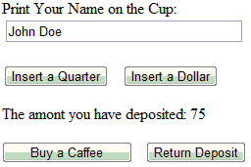
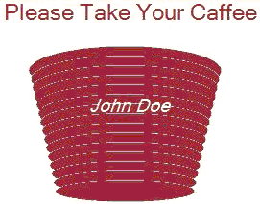
Using GDI+ Classes to Generate Dynamic Graphics
Input:
Dimensions
Shape
Text
Html page
Graphics Rendering in an ASPX page
Graphics Generation
Html stream
In a User Control
Html stream

Slide 7
Case Study: A Vending Machine with Dynamic Graphics
Textbook Chapter 5, Section 5.6
quarter
If (Sum>75)
Sum = Sum – 75
release coffee
If Sum < 75, do nothing
dollar
coffee
0
> 0
quarter
dollar
If (Sum== 75)
release coffee
Sum = Sum + 25
Sum = Sum + 100
return

Slide 8
GDI+ Classes to be Used in this Example
http://msdn.microsoft.com/en-us/library/aa925824.aspx
http://msdn.microsoft.com/en-us/library/aa983677(v=VS.71).aspx
Bitmap: Creating a bitmap pattern for drawing
Graphics: Creating an image on a Bitmap object of different formats: Gif, Jpeg, Png, etc.;
Pens: Draw lines, curves, and outline-shapes
Brushes: Create solid shapes and render text into images;
Colors: Used with Pens and Brushes to specify the colors to be rendered.

Slide 9
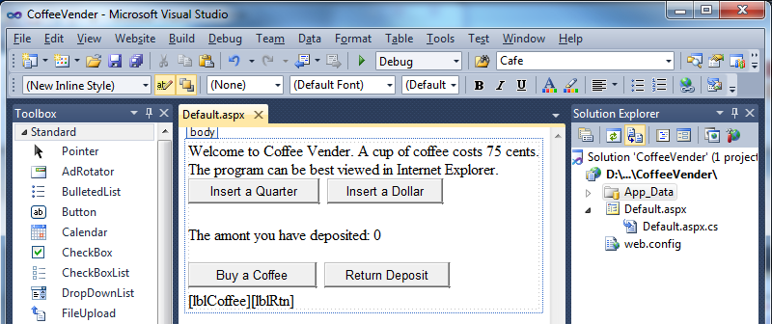
Coffee Vending Machine GUI Design
Take A Simple Approach to Getting Started with GDI+
Label to display the coffee cup
Label to display the returned coins

Slide 10
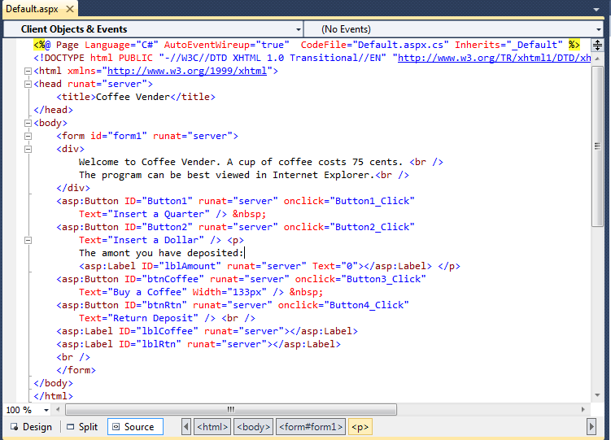
Default.aspx Source
Want to display the coffee cup at the label, but …
Want to display returned coins at the label, but …

Slide 11
Code Behind the Default.aspx Page (1)
using System;
using System.Drawing;
public partial class _Default : System.Web.UI.Page {
protected void Page_Load(object sender, EventArgs e) { // initialization
if (Session["Sum"] == null)
Session["Sum"] = 0;
lblAmount.Text = "0";
}
protected void Button1_Click(object sender, EventArgs e) { // insert quarter
Int32 Sum = (Int32)Session["Sum"];
Sum = Sum + 25;
Session["Sum"] = Sum;
lblAmount.Text = Convert.ToString(Sum);
lblRtn.Text = "[ ]";
}
// Continued on next page
quarter
If (Sum>75)
Sum = Sum – 75
release coffee
If Sum < 75, do nothing
coffee
dollar
0
> 0
dollar
quarter
If (Sum== 75)
release coffee
Sum = Sum + 25
Sum = Sum + 100
return

Slide 12
Code Behind the Default.aspx Page (2)
// from last page
protected void Button2_Click(object sender, EventArgs e)
{ // insert dollar
Int32 Sum = (Int32)Session["Sum"];
Sum = Sum + 100;
Session["Sum"] = Sum;
lblAmount.Text = Convert.ToString(Sum);
lblRtn.Text = "[ ]";
}
protected void Button3_Click(object sender, EventArgs e) { // buy a Coffee
Int32 Sum = (Int32)Session["Sum"];
if (Sum >= 75) {
Sum = Sum - 75;
Session["Sum"] = Sum;
lblAmount.Text = Convert.ToString(Sum);
lblCoffee.Text = "Please take your Coffee here";
lblRtn.Text = "[ ]";
quarter
If (Sum>75)
Sum = Sum – 75
release coffee
If Sum < 75, do nothing
dollar
coffee
0
> 0
dollar
quarter
If (Sum== 75)
release coffee
Sum = Sum + 25
Sum = Sum + 100
return

Slide 13
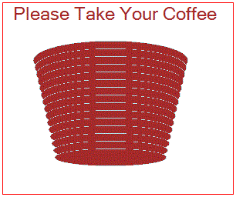
Code Behind the Default.aspx Page (3)
Bitmap imageCoffee = new Bitmap(300, 250);
Graphics gCoffee = Graphics.FromImage(imageCoffee);
gCoffee.FillRectangle(Brushes.White, 0, 0, 300, 250);
gCoffee.DrawRectangle(Pens.Red, 0, 0, 299, 249);
Font font = new Font("Alba Super", 18, FontStyle.Regular);
gCoffee.DrawString("Please Take Your Coffee", font, Brushes.Brown, 10, 0);
SolidBrush brownBrush = new SolidBrush(Color.Brown);
int x = 40; int y = 50; int w = 200; int h = 50;
for (int i = 0; i < 15; i++) {
Rectangle rec = new Rectangle(x, y, w, h);
gCoffee.DrawEllipse(Pens.PowderBlue, rec);
gCoffee.FillEllipse(brownBrush, rec);
x = x+2; y = y+10; w = w-4; h = h-2; }
imageCoffee.Save(Response.OutputStream, System.Drawing.Imaging.ImageFormat.Gif);
How do we draw the cup?

Slide 14
How do we draw the coffee cup?
// Repeat the code on the previous slide
for (int i = 0; i < 15; i++) {
Rectangle rec = new Rectangle(x, y, w, h);
gCoffee.DrawEllipse(Pens.PowderBlue, rec);
gCoffee.FillEllipse(brownBrush, rec);
x = x+2; y = y+10; w = w-4; h = h-2;
}
imageCoffee.Save(Response.OutputStream, System.Drawing.Imaging.ImageFormat.Gif);
Save the image as an HTML stream, in Gif format, as the response output stream. The label is not used.
1. Use rectangle to define dimensions first;
2. Use DrawEllipse to shape the object;
3. Use Brush to paint the color;
4. Use a list of decreasing ellipses to form the cup.

Slide 15
Code Behind the Default.aspx Page (4)
//Continuation of the code behind “Buy a Coffee”
gCoffee.Dispose(); // memory management
imageCoffee.Dispose();
}
}
else
{
lblCoffee.Text = "Please deposit more money";
lblAmount.Text = Convert.ToString(Sum);
lblRtn.Text = "[ ]";
}
}
quarter
If (Sum>75)
Sum = Sum – 75
release coffee
If Sum < 75, do nothing
dollar
coffee
0
> 0
dollar
quarter
If (Sum== 75)
release coffee
Sum = Sum + 25
Sum = Sum + 100
return

Slide 16
Code Behind the Default.aspx Page (5)
protected void Button4_Click(object sender, EventArgs e)
{ // return fund
Int32 Sum = (Int32)Session["Sum"];
if (Sum > 0)
{
lblRtn.Text = "Please take the money here";
RtnChanges(Sum); // Call another method to generate the image of the coins
Sum = 0;
Session["Sum"] = Sum;
}
else
lblRtn.Text = "You have not deposited money";
}
quarter
If (Sum>75)
Sum = Sum – 75
release coffee
If Sum < 75, do nothing
dollar
coffee
0
> 0
dollar
quarter
If (Sum== 75)
release coffee
Sum = Sum + 25
Sum = Sum + 100
return

Slide 17

Code Behind the Default.aspx Page (6)
protected void RtnChanges(Int32 amount) { // Generate the Image of Coins
Int32 quarters = (Int32)(amount/25); // Calculate the number of coins
Bitmap imageCoin = new Bitmap(300, 250);
Graphics gCoin = Graphics.FromImage(imageCoin);
gCoin.FillRectangle(Brushes.Gold, 0, 0, 300, 250);
Font font = new Font("Alba Super", 18, FontStyle.Italic);
gCoin.DrawString("Please Take Your Change", font, Brushes.Brown, 10, 0);
SolidBrush silverBrush = new SolidBrush(Color.Silver);
int x = 10; // initial position
int y = 50; // initial position
int w = 50;
int h = 50;
for (int i = 1; i <= quarters; i++) {
Rectangle rec = new Rectangle(x, y, w, h);
gCoin.DrawEllipse(Pens.PowderBlue, rec);
gCoin.FillEllipse(silverBrush, rec);

Slide 18
Code Behind the Default.aspx Page (7)
if (i < 5) // put 5 coins in a raw
{
x = x + 52;
}
else
{ // put remaining coins in the next raw
y=120;
x = x - 50;
}
}
imageCoin.Save(Response.OutputStream, System.Drawing.Imaging.ImageFormat.Gif);
gCoin.Dispose(); // housekeeping
imageCoin.Dispose();
}
} // End of the code
Save the image as an HTML stream, in Gif format, as the response output stream. The label is not used.

Slide 19
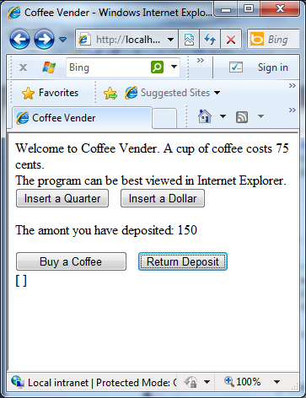
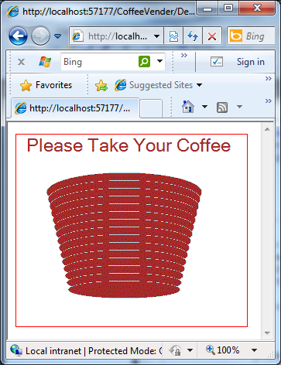
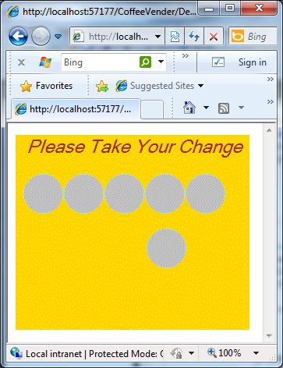
Demonstration
http://venus.eas.asu.edu/WSRepository/CoffeeVender/

Slide 20
Problems with the Simple Example
This simple example shows how dynamic graphics can be generated and displayed:
As a simple working example, the details are not fine-tuned.
The image overwrites the entire html page;
The rendered file is sent to the web forms, which seems to be browser-dependent:
The graphics works on IE;
The graphics does not work on Chrome and Firefox

Slide 21
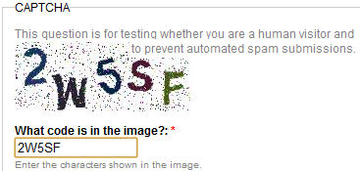
A Refined Implementation
http://venus.eas.asu.edu/WSRepository/CoffeeMachine/
The image is posted to the same web page without overwriting the forms;
Use “User Control” to implement the image generation
It works for IE, Chrome, and Firefox;
Take user-entered text (user name) and print the name on the coffee cup:
Potential application of implementing an image verifier to prevent programmed attacks

Slide 22
File Organization
Main GUI Page
Default.aspx
Default.aspx.cs
Register the user control
Image to be placed here
Image generated here
UserControlCup.ascx
UserControlCup.ascx.cs
User Control

Slide 23
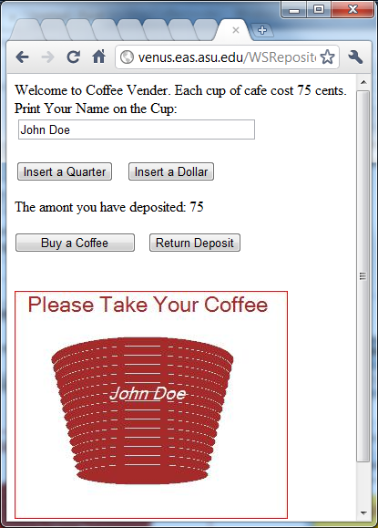
Demonstration and an Application
Demo for Image Verifier: http://venus.eas.asu.edu/WSRepository/CoffeeMachine/
Generate a random string
Generate
image
2W5SF
=?
Image Verifier
Image Verifier

Slide 24
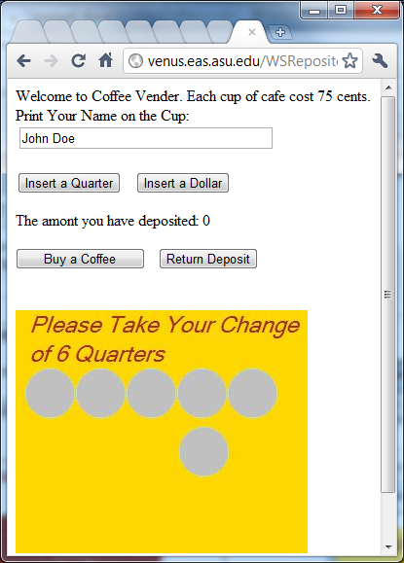
Demonstration of CoffeeMachine
http://venus.eas.asu.edu/WSRepository/CoffeeMachine/
Calculating the change in the number of quarter

Slide 25
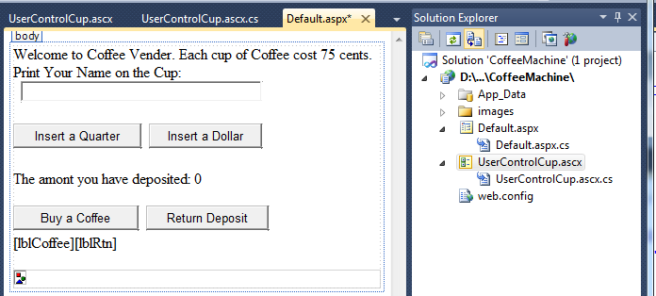
Default.aspx Design with User Control
Display image generated by the user control here

Slide 26
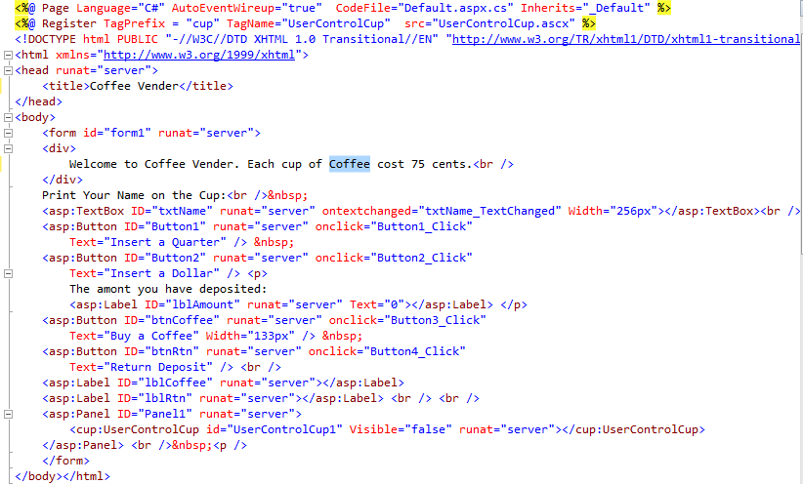
Default.aspx Source with User Control
Register the user control
Where to place the image
The image will not be displayed initially.

Slide 27
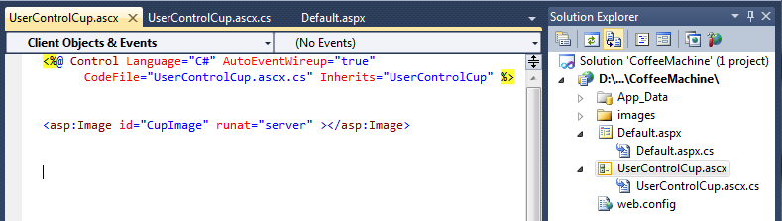
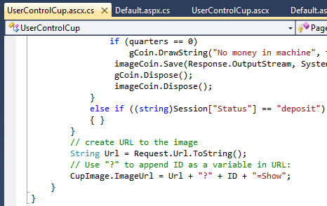
Source of the UserControlCup.ascx
Define the id = “CupImage” of the image generated by the user control. This id is used in the code behind the User Control to refer to the image.

Slide 28

Code Behind Default.aspx Page (1)
There is not much difference from the code in the previous example
using System;
public partial class _Default : System.Web.UI.Page {
protected void Page_Load(object sender, EventArgs e) {
if (Session["Sum"] == null)
Session["Sum"] = 0;
if (Session["Status"] == null)
Session["Status"] = "deposit";
lblAmount.Text = "0";
}
protected void Button1_Click(object sender, EventArgs e)
{ // insert quarter
Int32 Sum = (Int32)Session["Sum"];
Sum = Sum + 25;
Session["Sum"] = Sum;
lblAmount.Text = Convert.ToString(Sum);
UserControlCup1.Visible = false; // Hide the Image Display
Session["Status"] = "deposit";

Slide 29
Code Behind Default.aspx Page (2)
if (Sum < 75)
lblCoffee.Text = "Please deposit more money";
else
lblCoffee.Text = String.Empty;
}
protected void Button2_Click(object sender, EventArgs e)
{ // insert dollar
Int32 Sum = (Int32)Session["Sum"];
Sum = Sum + 100;
Session["Sum"] = Sum;
lblAmount.Text = Convert.ToString(Sum);
UserControlCup1.Visible = false; // Hide the Image Display
Session["Status"] = "deposit";
lblCoffee.Text = String.Empty;
}

Slide 30

Code Behind Default.aspx Page (3)
protected void Button3_Click(object sender, EventArgs e) { // buy Coffee
Int32 Sum = (Int32)Session["Sum"];
if (Sum >= 75) {
Sum = Sum - 75;
Session["Sum"] = Sum;
lblAmount.Text = Convert.ToString(Sum);
//lblCoffee.Text = "Please take your Coffee here";
Session["Status"] = "coffee";
UserControlCup1.Visible = true; // Display the Coffee Cup
}
else {
lblCoffee.Text = "Please deposit more money";
lblAmount.Text = Convert.ToString(Sum);
UserControlCup1.Visible = false; // No Display
}
}

Slide 31

Code Behind Default.aspx Page (4)
protected void Button4_Click(object sender, EventArgs e)
{ // return fund
Int32 quarters = (Int32)((Int32)Session["Sum"] / 25);
Session["Qarters"] = quarters;
Session["Sum"] = 0;
Session["Status"] = "refund";
UserControlCup1.Visible = true; // Display the returned coins
lblCoffee.Text = String.Empty;
}
protected void txtName_TextChanged(object sender, EventArgs e)
{
if (txtName != null)
Session["YourName"] = txtName.Text;
}
}
This is an event handler behind textbox
This is an event handler behind textbox

Slide 32
Code behind the User Control (1)
using System;
using System.Drawing;
public partial class UserControlCup : System.Web.UI.UserControl {
protected void Page_Load(object sender, EventArgs e) {
if (Request.Params[ID] != null) {
if ((string)Session["Status"] == "coffee") // Display Coffee Cup {
Bitmap imageCoffee = new Bitmap(300, 250);
Graphics gCoffee = Graphics.FromImage(imageCoffee);
gCoffee.FillRectangle(Brushes.White, 0, 0, 300, 250);
gCoffee.DrawRectangle(Pens.Red, 0, 0, 299, 249);
Font font = new Font("Alba Super", 18, FontStyle.Regular);
gCoffee.DrawString("Please Take Your Coffee", font, Brushes.Brown, 10, 0);
SolidBrush brownBrush = new SolidBrush(Color.Brown);
int x = 40;
int y = 50;
int w = 200;
int h = 50;

Slide 33
Code behind the User Control (2)
for (int i = 0; i < 15; i++) {
Rectangle rec = new Rectangle(x, y, w, h);
gCoffee.DrawEllipse(Pens.PowderBlue, rec);
gCoffee.FillEllipse(brownBrush, rec);
x = x + 2; y = y + 10;
w = w - 4; h = h - 2;
}
if (Session["YourName"] != null) {
font = new Font("Alba Super", 14, FontStyle.Italic);
String NameOnCup = (String)Session["YourName"];
gCoffee.DrawString(NameOnCup, font, Brushes.White, 100, 100);
}
imageCoffee.Save(Response.OutputStream, System.Drawing.Imaging.ImageFormat.Jpeg);
gCoffee.Dispose();
imageCoffee.Dispose();
}
Print the name on cup

Slide 34
Code behind the User Control (3)
else if ((string)Session["Status"] == "refund") { //Display coins
Int32 quarters = (Int32)Session["Qarters"];
Session["Status"] = "deposit";
Bitmap imageCoin = new Bitmap(300, 250);
Graphics gCoin = Graphics.FromImage(imageCoin);
gCoin.FillRectangle(Brushes.Gold, 0, 0, 300, 250);
Font font = new Font("Alba Super", 18, FontStyle.Italic);
if (quarters > 0) {
gCoin.DrawString("Please Take Your Change", font, Brushes.Brown, 10, 0);
String coins = "of " + quarters + " Quarters";
gCoin.DrawString(coins, font, Brushes.Brown, 10, 30);
SolidBrush silverBrush = new SolidBrush(Color.Silver);
int x = 10; // from left
int y = 60; // from top
int w = 50;
int h = 50;

Slide 35
Code behind the User Control (4)
for (int i = 1; i <= quarters; i++) { // Display coins one after another
Rectangle rec = new Rectangle(x, y, w, h);
gCoin.DrawEllipse(Pens.PowderBlue, rec);
gCoin.FillEllipse(silverBrush, rec);
if (i < 5) { x = x + 52; }
else {
y = 120;
x = x - 50;
}
}
}
if (quarters == 0)
gCoin.DrawString("No money in machine", font, Brushes.Brown, 10, 0);
imageCoin.Save(Response.OutputStream, System.Drawing.Imaging.ImageFormat.Jpeg);
gCoin.Dispose();
imageCoin.Dispose();
}

Slide 36
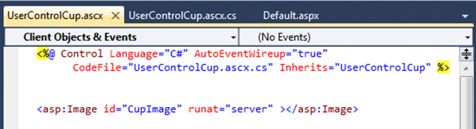
Code behind the User Control (5)
else if ((string)Session["Status"] == "deposit") // No Display
{ }
}
String Url = Request.Url.ToString();
if (Url.IndexOf("?") == -1)
{
CupImage.ImageUrl = Url + "?" + ID + "=Show";
}
else
{
CupImage.ImageUrl = Url + "&" + ID + "=Show";
}
}
}
Obtain the URL of the request
Is “?” used in the URL
Use “&” to separate argument
Use “?” to separate argument
Generated URL of the image.

Slide 37
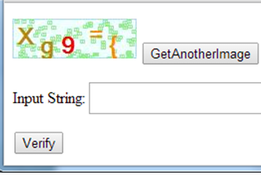
How Do I call the Image Verifier Service?
public partial class ImageVerifier : System.Web.UI.Page {
protected void Page_Load(object sender, EventArgs e) {
Image1.ImageUrl = "~/Image.aspx";
}
protected void Button1_Click(object sender, EventArgs e) {
if (Session["verifyStr"].Equals(TextBox1.Text)) {
// Your input is correct, and can access
Response.Redirect("Account/Register.aspx");
}
else {
Label1.Text = "Your input is not correct!";
Session["verifyStr"] = null;
}
}
protected void Button2_Click(object sender, EventArgs e) {
MyService.ServiceClient myClient = new MyService.ServiceClient();
string myStr = myClient.GetVerifierString("5");
Session["verifyStr"] = myStr;
}
}
Call image service
Call image service
http://venus.eas.asu.edu/WSRepository/Services/ImageVerifierSvc/Service.svc
http://venus.eas.asu.edu/WSRepository/Services/ImageVerifierSvc/TryIt.aspx

Slide 38
From GDI+ to PF and Silverlight Graphics
ASP .Net support 2-D basic graphic and image classes
Presentation Foundation (for Windows Forms Application) and Silverlight (for Web Site Applications) have largely extended the capacity;
Shape classes: Rectangle, Ellipse, Line, Polyline, polygon, path
Brush Classes: SolidColorBrush, LineGradientBrush, RadialGradientBrush, ImageBrush, VideoBrush, WebBrowserBrush
Transform Classes: TranslateTransform, RotateTransform, ScaleTransform, SkewTransform, CompositeTransform, MatricTransform;
WriteableBitmap: Directly modify bitmap pixels in array format
Animation: Various transitions of objects
Programming models: in C# and in XMAIL markup language

Slide 39

Example of Using WritableBitmap
public static MemoryStream RotateStream(MemoryStream myImage) {
BitmapImage myBitmap = new BitmapImage();
bitmap.SetSource(myImage);
WriteableBitmap mySource = new WriteableBitmap(myBitmap);
WriteableBitmap myTarget = new
WriteableBitmap(mySource.PixelHeight, mySource.PixelWidth);
for (int x = 0; x < mySource.PixelWidth; x++) {
for (int y = 0; y < mySource.PixelHeight; y++) // transformation pixel by pixel
myTarget.Pixels[(mySource.PixelHeight-y-1) + x*myTarget.PixelWidth]
= mySource.Pixels[x + y * mySource.PixelWidth];
}
MemoryStream myStream = new MemoryStream();
myTarget.SaveJpeg(myStream,
myTarget.PixelWidth, myTarget.PixelHeight, 0, 100);
return myStream;
}
Height and Width swapped order
Height and Width swapped order
Height
Height
Width
Width

Slide 40
Visual Studio Development Environment
Desktop Software Development
Web Software Development
Workflow Foundation
WPF:
Windows Presentation Foundation
ASP .Net Web Site
JavaScript, AJAX
HTML, CSS, XSL
ASP .Net Windows Forms Applications
Silverlight Constructs
Silverlight Applications
Windows Communication Foundation
GDI+
DLL and components
Framework Class Library
User controls
Server controls
Common Language Runtime

Slide 41
Silverlight Components / Controls
Getting Started: http://www.silverlight.net/learn/overview/what-is-silverlight
Common controls:
Textbox, Checkbox, RadioButton, ComboBox, …
TabControl, ScrollViewer, ProgressBar, SpeedBar, …
Extensible control base classes
Layout controls:
Grid, StackPanel
Data controls:
DataGrid, TexBlock, etc.
Data:
2-way data binding
More LINQ support: LINQ to XML
Grid
StackPanel
TextBlock
TextBlock
TextBlock

Slide 42
Silverlight Animation
In addition to the dynamic Graphic classes, Silverlight also supports animation of objects of animation classes.
Linear interpretation: The object moves smoothly from point A to point B
DoubleAnimation
PointAnimation
ColorAnimation
Key-frame animation: Object jump from point A to point B
DoubleAnimationUsingKeyFrames
PointAnimationKeyUsingFrames
ColorAnimationUsingKeyFrames
ObjectAnimationUsingKeyFrames
Each animation can be implemented (coded)
in XAML or
in C# code behind XAML

Slide 43
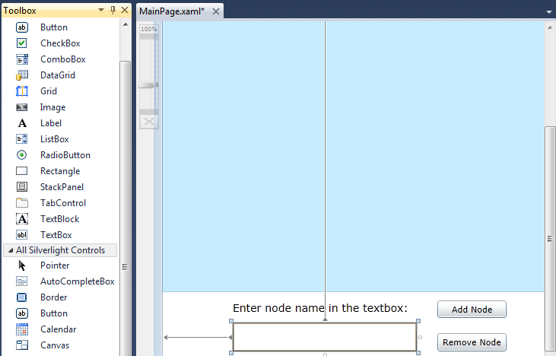
Creating a Silverlight Application Example
MainPage.xaml: Creating the GUI:
A canvas for dynamic objects to move around
Other I/O controls, e.g., textboxes, buttons, and labels

Slide 44
Code behind MainPage: MainPage.xaml.cs
namespace LinkedList {
public partial class MainPage : UserControl {
private MasterList list;
public MainPage() {
InitializeComponent(); list = new MasterList(mainSpace);
}
private void addButton_Click(object sender, RoutedEventArgs e) {
list.addLast(textBox.Text); textBox.Text = "";
}
private void removeButton_Click(object sender, RoutedEventArgs e) {
list.remove(textBox.Text); textBox.Text = "";
}
private void entercapture(object sender, KeyEventArgs e) {
if (e.Key == Key.Enter) {
list.addLast(textBox.Text); textBox.Text = "";
}
}
}
If Enter key is pressed

Slide 45
Code behind MainPage: MainPage.xaml.cs
public void animateLastAdd() {
DoubleAnimation upperAnimation = new DoubleAnimation();
DoubleAnimation lowerAnimation = new DoubleAnimation();
DoubleAnimation nullAnimation = new DoubleAnimation();
DoubleAnimation valueAnimation = new DoubleAnimation();
Duration duration = new Duration(TimeSpan.FromSeconds(1.5));
upperAnimation.Duration = duration; lowerAnimation.Duration = duration;
valueAnimation.Duration = duration; nullAnimation.Duration = duration;
Storyboard story = new Storyboard(); story.Duration = duration;
story.Children.Add(lowerAnimation); story.Children.Add(upperAnimation);
story.Children.Add(nullAnimation); story.Children.Add(valueAnimation);
Storyboard.SetTargetProperty(upperAnimation, new PropertyPath("(Canvas.Top)"));
Storyboard.SetTargetProperty(lowerAnimation, new PropertyPath("(Canvas.Top)"));
Storyboard.SetTargetProperty(nullAnimation, new PropertyPath("(Canvas.Top)"));
Storyboard.SetTargetProperty(valueAnimation, new PropertyPath("(Canvas.Top)"));
Storyboard.SetTarget(upperAnimation, upperBox); upperAnimation.To = 70;
Storyboard.SetTarget(valueAnimation, valueLabel); valueAnimation.To = 70;
Storyboard.SetTarget(lowerAnimation, lowerBox); lowerAnimation.To = 100;
Storyboard.SetTarget(nullAnimation, nullLabel); nullAnimation.To = 100;
story.Begin(); }

Slide 46
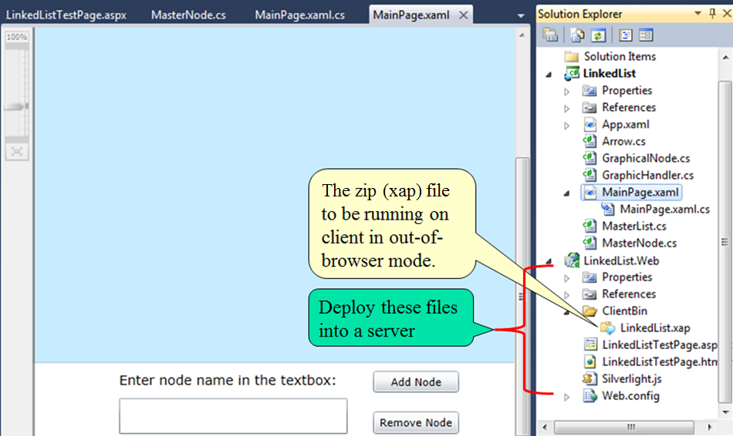
Silverlight App Deployment

Slide 47
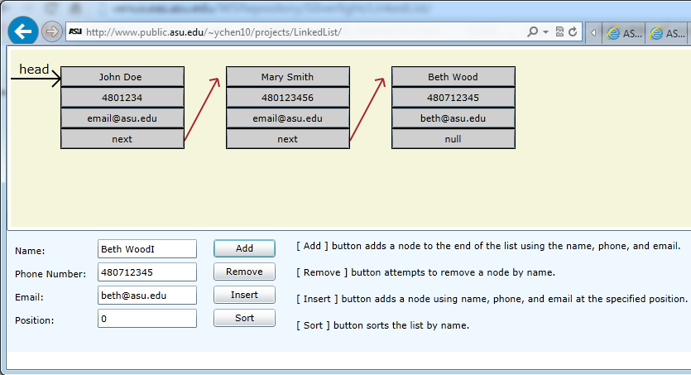
Silverlight App Test
On computing server
http://venus.eas.asu.edu/WSRepository/Silverlight/LinkedList/
On data server
http://www.public.asu.edu/~ychen10/projects/LinkedList/

Slide 48
Lecture Summary
The principles of using dynamic graphics
The model of generating dynamic graphics
Visual Studio GDI+ library
Simple Example of Generating Dynamic Graphics posting the image into the ASPX forms
Using User Control to generate images and confine the images in a part of the form.
Potential application in developing an image verifier, See text Section 7.3.4 for developing an image verifier.
Silverlight and Animation

